Slide 1

Mini Project-2 (ID201B) EVEN Semester Session 2024-25
BUDGET TRACKER AND MANAGEMENT
<GAURAV VISHWAKARMA and 2426MCA1506>
<DIVYANSH PATHAK and 2426MCA656>
<DIVYANSHU MISHRA and 2426MCA657>
<GAURAV CHAUHAN and 2426MCA1916>
Project Supervisor:
MS. SHRUTI AGGARWAL
Designation-Assistant Professor

Slide 2
CONTENT
1. INTRODUCTION
2. KEY MODULES AND
FEATURES
3. TECHNOLOGY STACK
4. FUTURE ENHANCEMENTS
5. CONCLUSION

Slide 3
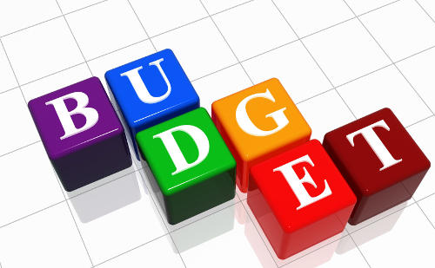
INTRODUCTION
🔹 The Budget Tracker is a web-based financial management system
designed to help users track their income, expenses, savings, and
investments efficiently.
🔹 It includes essential modules like Login, Register, and Home,
ensuring a secure and personalized experience for each user.
🔹 Users can categorize their transactions under different sections
such as Marketing, Expenses, Savings, Investments, and other
customizable categories, allowing for detailed financial tracking.
🔹 Overall, the Budget Tracker helps individuals manage their finances
efficiently by offering a structured approach to budgeting, saving, and investing,
ultimately leading to better financial planning.

Slide 4

KEY MODULES & FEATURES
🔹 User Authentication Module ➤ Secure login & registration system. ➤ Ensures data privacy and user-specific access.
🔹 Dashboard Module ➤ Displays total income, expenses, and balance. ➤ Provides recent transactions and graphical insights.
🔹 Income Management Module ➤ Allows users to add, edit, and categorize income sources. ➤ Provides a history of income transactions.
🔹 Expense Management Module ➤ Users can log expenses, categorize them, and filter by date. ➤ Offers editing and deleting options for transactions.

Slide 5
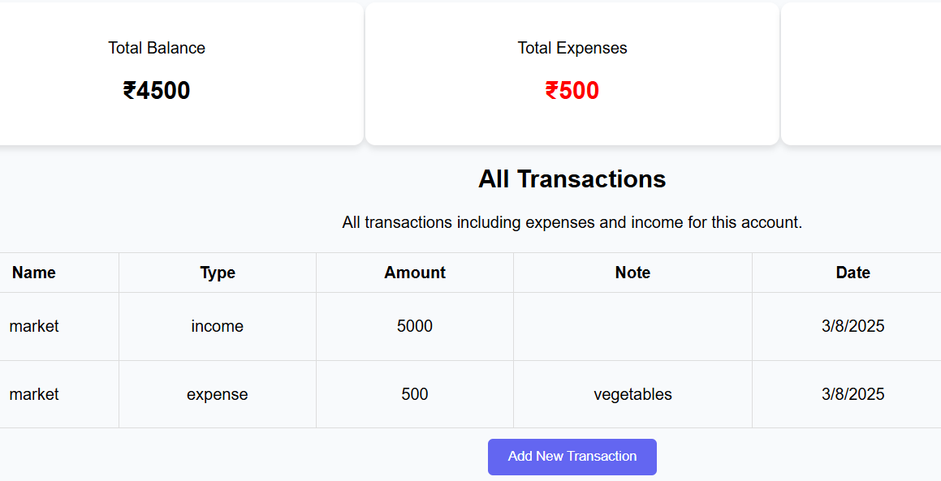
Additional Features that make us unique
🔹 Budget Management Module ➤ Set monthly budgets for different categories. ➤ Get alerts when the budget limit is reached.
🔹 Split Bill Module (Unique Feature) ➤ Easily split shared expenses among friends or family. ➤ Auto-calculates and assigns dues to each person.
🔹 Data Visualization Module ➤ Graphs & charts for income vs. expense analysis. ➤ View spending trends with pie and bar charts.
🔹 Reports & Export Module ➤ Download financial summaries in PDF/CSV format. ➤ Generate monthly & annual reports for tracking.

Slide 6
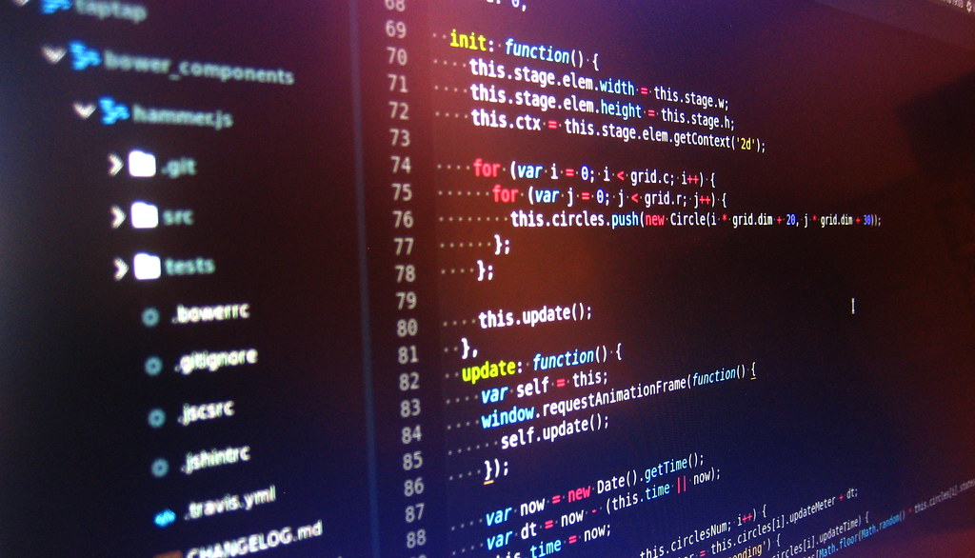
TECHNOLOGY STACK
🔹 Frontend: Developed using HTML, CSS, and
JavaScript, ensuring a responsive and visually
appealing user interface
for smooth interaction.
🔹 Backend: Built with Node.js, enabling efficient
server-side processing and handling of user requests
for a seamless
experience.
🔹 Database: Utilizes MongoDB, a flexible and scalable
NoSQL database for securely storing user transactions and
financial data.
🔹 Libraries: Integrated Chart.js, a powerful JavaScript
library that provides interactive graphs and visualizations
for better financial insights.

Slide 7


Future Enhancements for Large scale development
BANK ACCOUNT INTEGRATION
VOICE-COMMAND INPUT
AI-BASED EXPENSE SUGGESTIONS
MULTI-CURRENCY SUPPORT

Slide 8
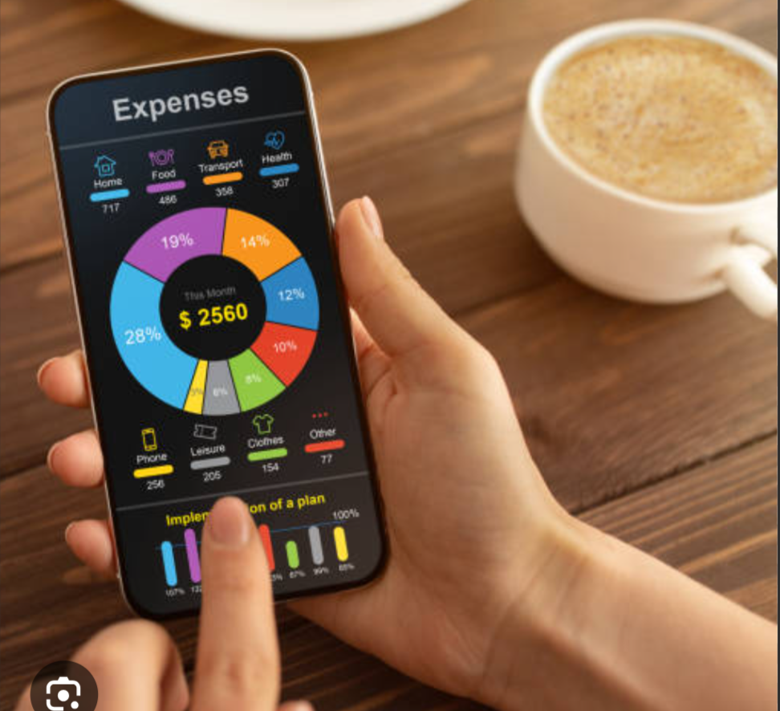
CONCLUSION
The Budget Tracker helps users track expenses, analyze
spending patterns, and set budgets.
It provides a simple yet powerful solution to achieve better
financial planning and savings.
With future enhancements, this project can become an AI-driven
smart finance assistant. explain in brief.

Slide 9


